Slide 1
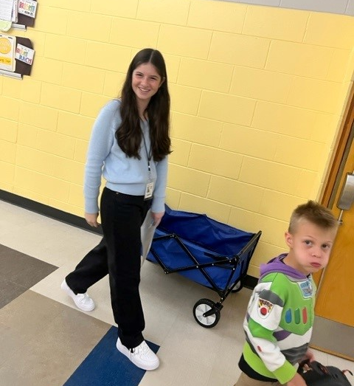
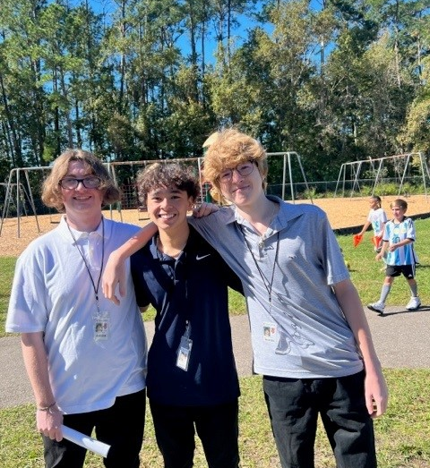
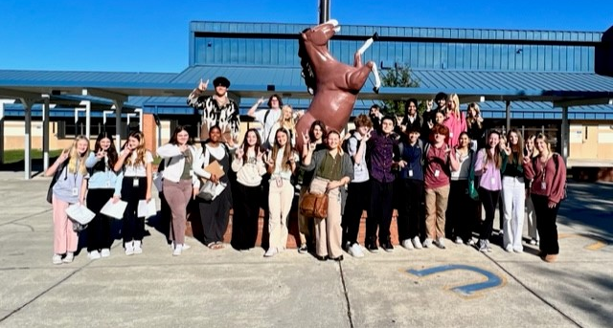
St.Johns County Academy of Future Educators

Slide 2
St. Johns Academy of Future Educators
This academy offers students a sequence of courses needed to become a professional in the field of education. This includes an understanding of education in the United States, the ability to work effectively with all students, educational technology, classroom management, student assessment, communication skills, and other skills needed to support the learning activities of students in today’s classrooms.
Industry Certifications
WordPress
Florida Teacher Certification Examinations (FTCE)- Professional Education Test (FLDOE04)
CPR (infant) certification
200 hours of internship experience
Dual enrollment through UNF for 4th year

Slide 3
FRAMEWORKS

Slide 4
