Slide 1
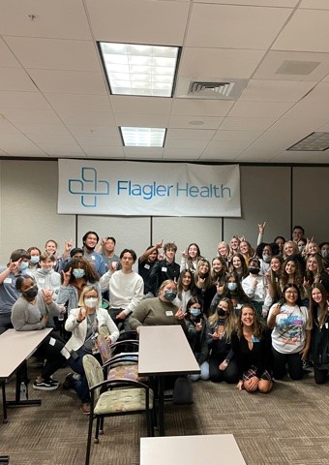
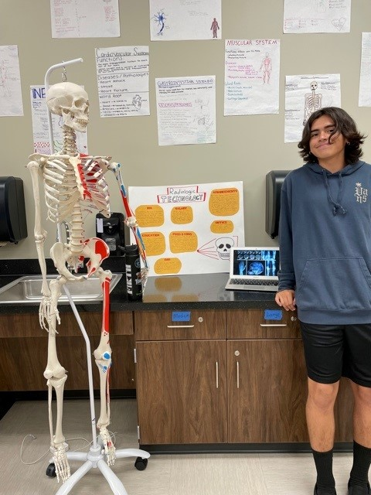
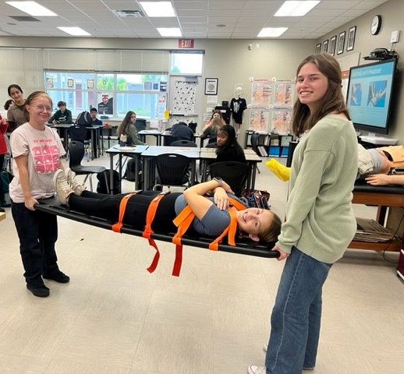
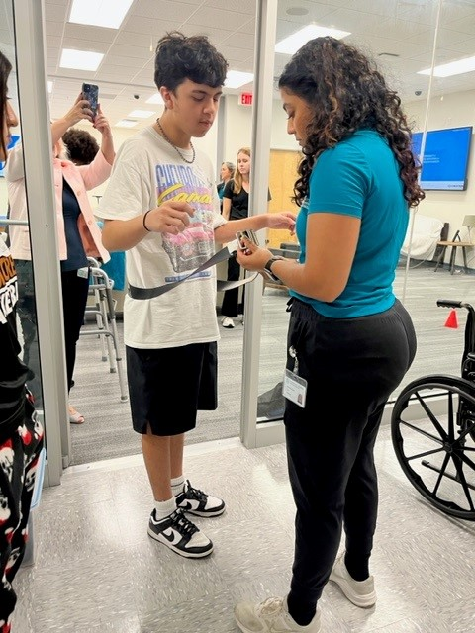


Slide 2

What is an Academy?
A small learning community within the school
Focused and rigorous courses in a specific area
Real-world experience to prepare you for the jobs of tomorrow
Hands-on projects (Project-based learning)
Make you more competitive for college and careers
Help you in choosing your college major or career field early

Slide 3
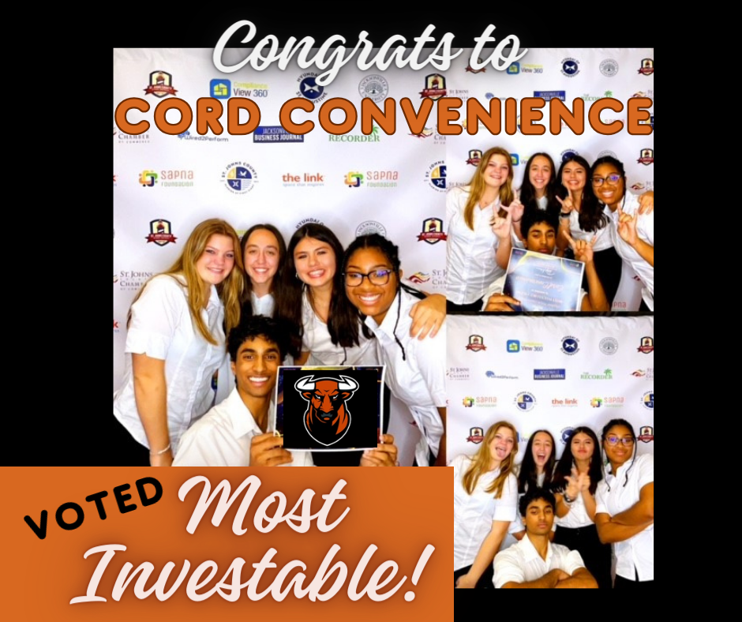

UF Health St. Johns Academy of Future Healthcare Professionals
This academy is focused on developing a deep understanding of healthcare professions. The electives in this academy will offer students an opportunity to explore careers in healthcare, learn human anatomy, and study disease. Students will be able to visit healthcare facilities, participate in job-shadowing rotations, and gain real-world experiences in the medical field.
Industry Certifications
  EKG Technician
  Emergency Medical Responder
  BLS/CPR certification

Slide 4
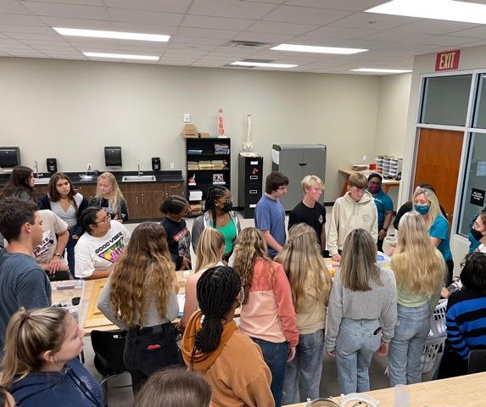
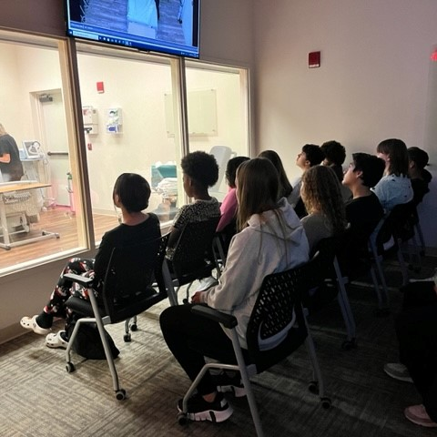
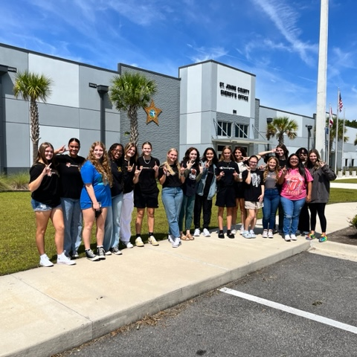
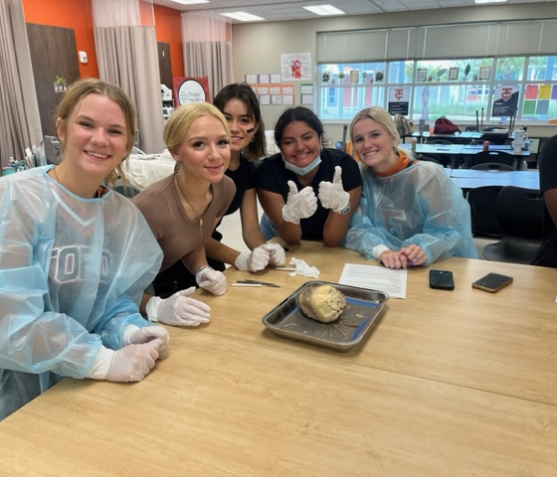
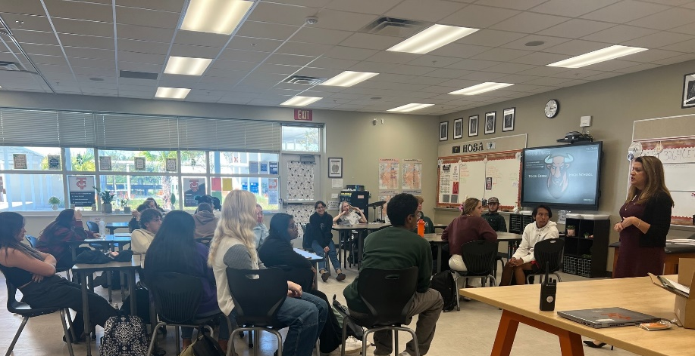
Learn from Industry Experts
Guest Speakers
Field Trips
Job-Shadowing
Summer Internships

Slide 5

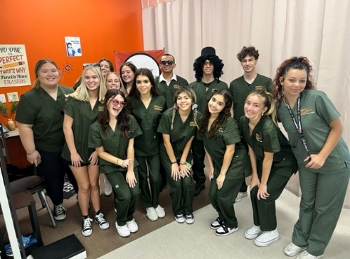
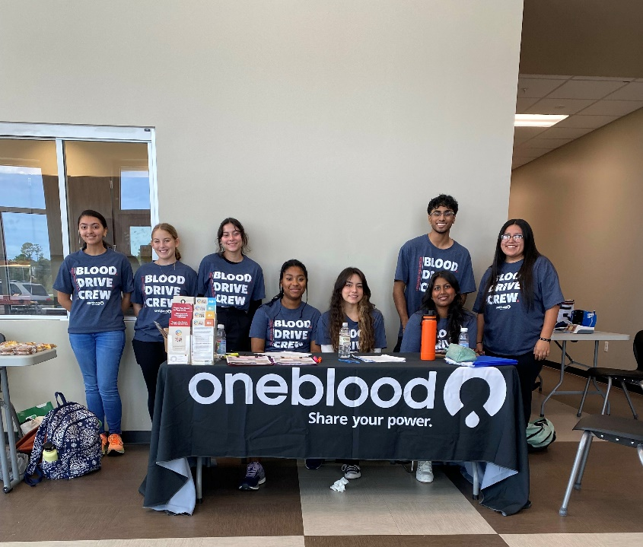
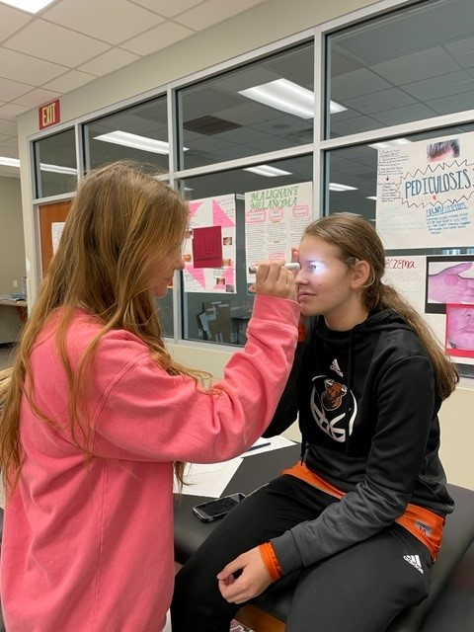
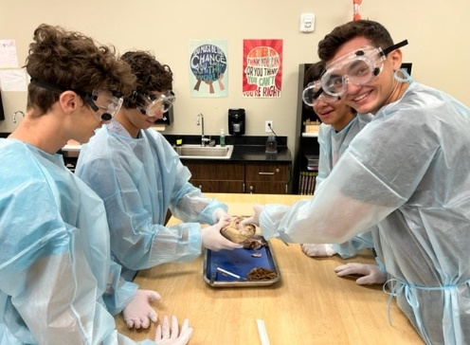
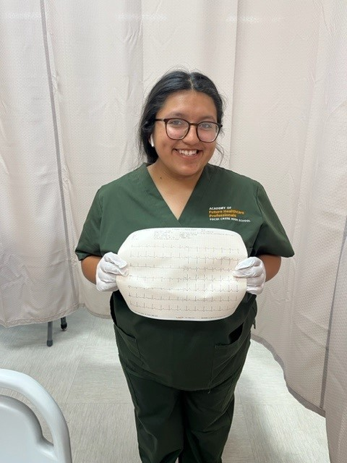
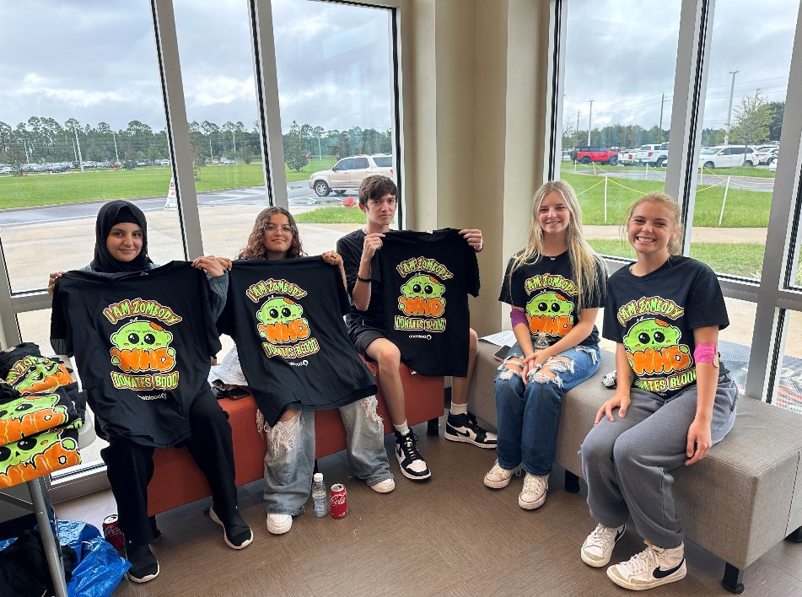
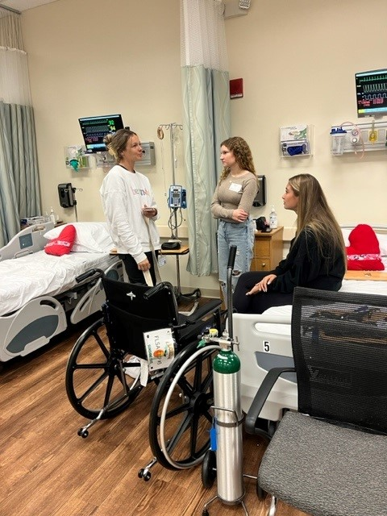
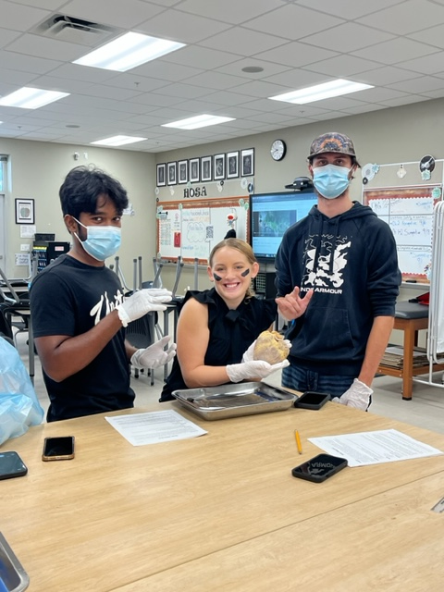

Slide 6
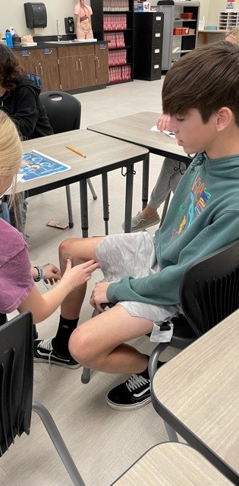
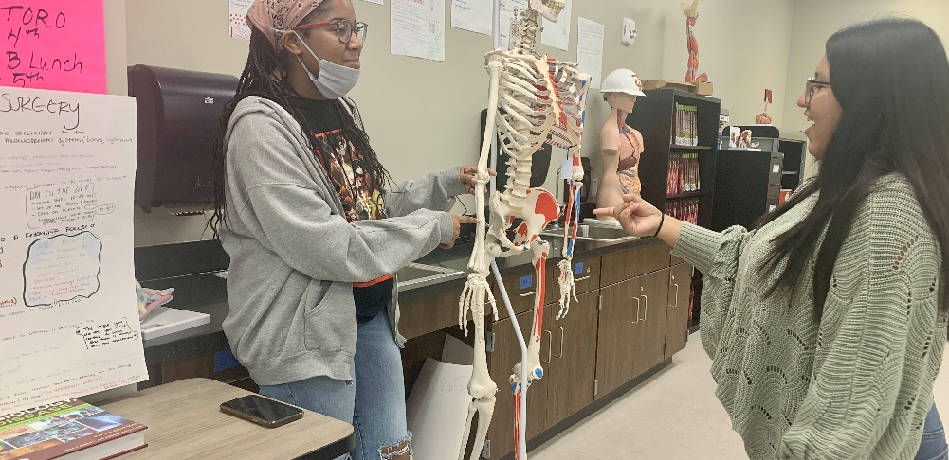
Project-Based Learning

Slide 7
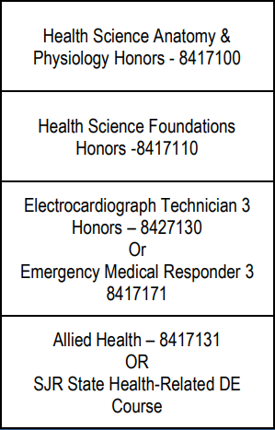
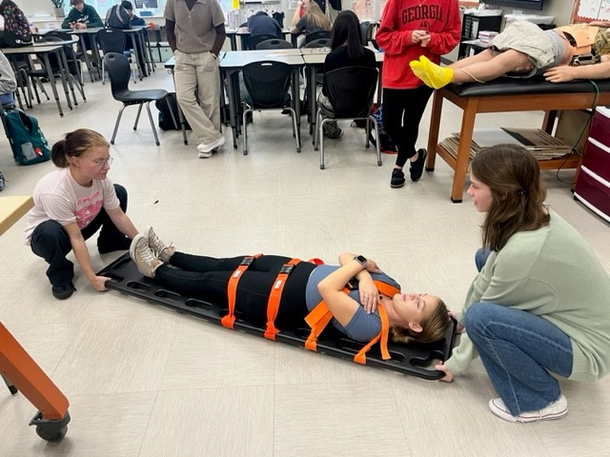
Rigorous and Relevant Curriculum
By enrolling in a Career Academy, you can receive a great education and authentic experience to prepare you for the high-wage, high-skill, and high-demand jobs of tomorrow.

Slide 8
Application Process
Complete online application through student’s Home Access Center (HAC).
  Opens January 4, 2024
  Closes January 31, 2024 @ 5:00 pm
If applying for IB or AICE, request a completed Teacher Recommendation form from your four core content area teachers.
If applying for SJCCA, apply and audition by January 24, 2024.
Registration information: https://cte.stjohns.k12.fl.us/academies/
*NOTE: If students attend a school other than their zoned school, they must provide their own transportation.

Slide 9
FAQ
Students must apply through their HAC login. Application will NOT be available through parent login.
Current St. Johns County residents must apply during application window.
Non-SJCSD students must pre-register for following school year and apply during application window.
Late Application may not be used for a secondary application
Common Application Errors
  Multiple 1st Choice Options
  Applications for a duplicate program at zoned school
  Multiple applications for one student
  More than three selections
  Duplicate Academy selections
  Student is already enrolled in an Academy

